Slide 1


International University
MICRO-PROCESSING SYSTEM
Lecture 1_A:
Introduction To AVR Microcontroller Architecture and Basic Assembly Programming
Vo Minh Thanh, M.Eng
School Of Electrical Engineering

Slide 2
Topics
Microcontrollers vs. Microprocessors
Most common microcontrollers
AVR Microcontroller Architecture
Introduction To ATMega32 Architecture
Introduction To Basic AVR Assembly Programming

Slide 3
Topics
Microcontrollers vs. Microprocessors
Most common microcontrollers
AVR Microcontroller Architecture
Introduction To ATMega32 Architecture
Introduction To Basic AVR Assembly Programming

Slide 4
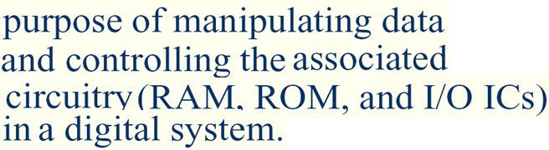
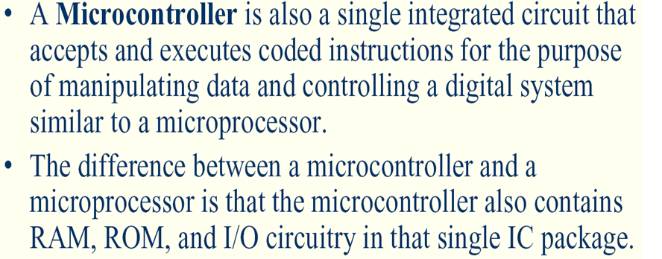
Review General Purpose Microprocessors vs. Microcontrollers
General Purpose Microprocessors
General
Purpose
Micro
processor
Data BUS
RAM
ROM
Timer
Serial
COM
Port
IO
Port
Address BUS
Control BUS
Microprocessor, by-itself, completely useless – must have external peripherals to Interact with outside world
Microcontrollers
CPU
RAM
ROM
Serial
Port
Timer
I/O

Slide 5
Topics
Microcontrollers vs. Microprocessors
Most common microcontrollers
AVR Microcontroller Architecture
Introduction To ATMega32 Architecture
Introduction To Basic AVR Assembly Programming

Slide 6
Most common microcontrollers
8-bit microcontrollers
  AVR
  PIC
  ARM
  HCS12
  8051
32-bit microcontrollers
  ARM
  PIC32

Slide 7
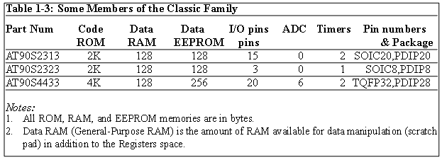
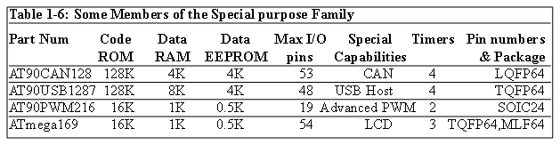
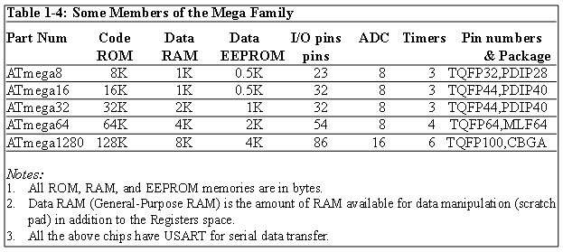
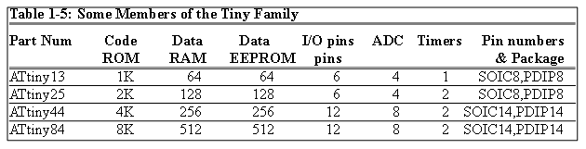
AVR different groups
Classic AVR
  e.g. AT90S2313, AT90S4433
Mega
  e.g. ATmega8, ATmega32, ATmega128
Tiny
  e.g. ATtiny13, ATtiny25
Special Purpose AVR
  e.g. AT90PWM216,AT90USB1287

Slide 8
Let’s get familiar with the AVR part numbers
ATmega128
Atmel
group
Flash =128K
ATtiny44
AT90S4433
Atmel
Tiny group
Flash =4K
Atmel
Classic group
Flash =4K

Slide 9
Topics
Microcontrollers vs. Microprocessors
Most common microcontrollers
AVR Microcontroller Architecture
Introduction To ATMega32 Architecture
Introduction To Basic AVR Assembly Programming

Slide 10
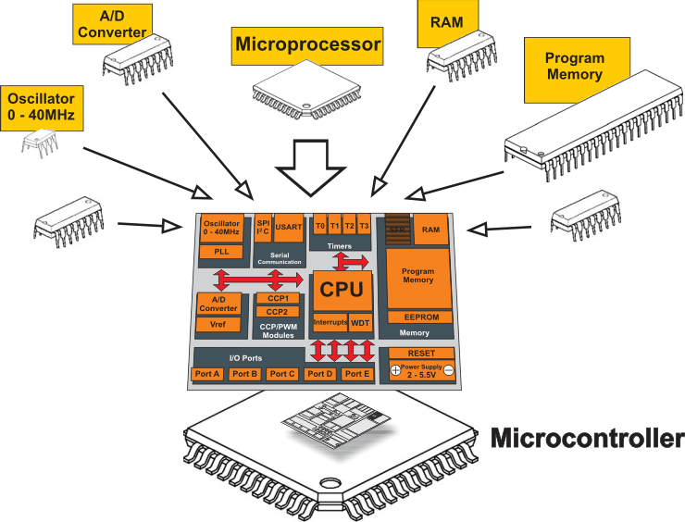
AVR Microcontroller Architecture

Slide 11
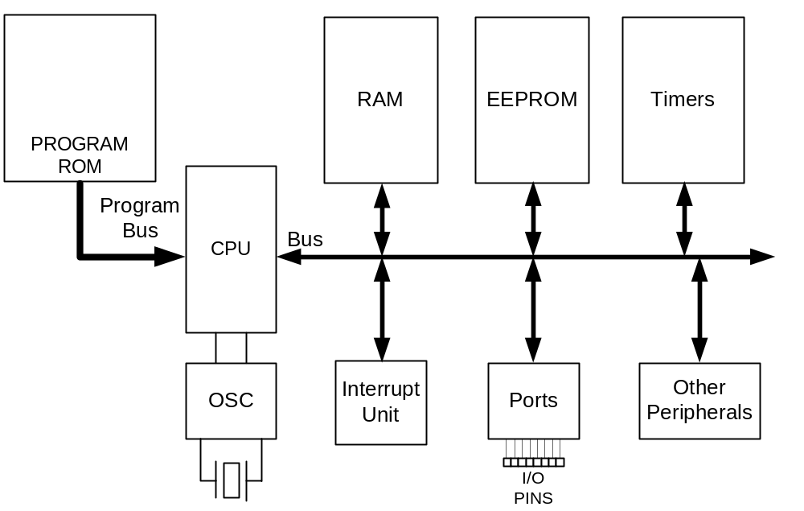
AVR internal architecture

Slide 12
Topics
Microcontrollers vs. Microprocessors
Most common microcontrollers
AVR Microcontroller Architecture
Introduction to ATMega32 Architecture
Introduction To Basic AVR Assembly Programming

Slide 13
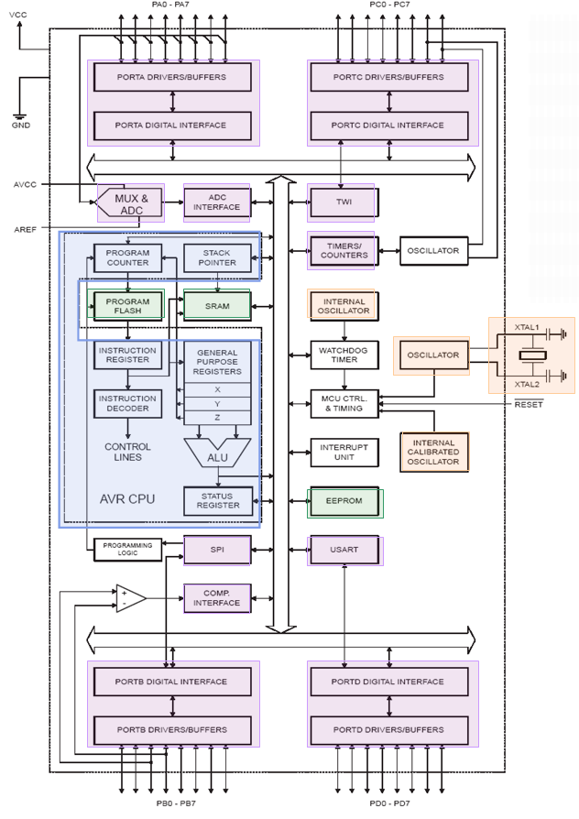
ATMega32 Architecture
An 8-bit microcontroller featuring:
Data size is 8 bits (1 byte).
Uses 16-bit data addressing allowing it to address 2^16 = 65536 unique addresses.
Has three separate on-chip memories
  2KB SRAM: 8 bits wide used to store data
  1KB EEPROM: 8 bits wide used for persistent data storage
  32KB Flash: 16 bits wide used to store program code
I/O ports A-D
  Digital input/output
  Analog input
  TIMERS
  Pulse accumulator
  Interupt Unit
  Serial/Parallel
  UART
  SPI
  I2C

Slide 14
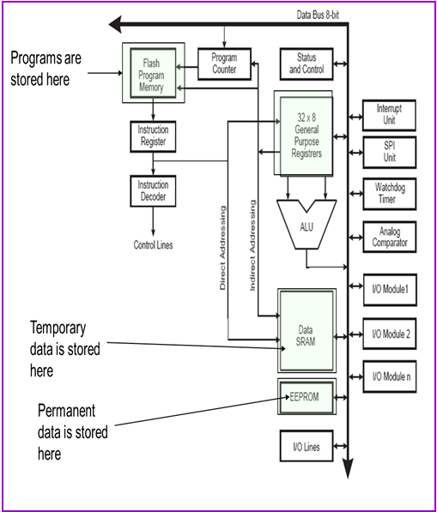
ATMega32 : Memory
2KB SRAM
  For temporary data storage
  Memory is lost when power is shut off (volatile)
  Fast read and write
1KB EEPROM
  For persistent data storage
  Memory contents are retained when power is off (non-volatile)
  Fast read; slow write
  Can write individual bytes
32KB Flash Program Memory
  Used to store program code
  Memory contents retained when power is off (non-volatile)
  Fast to read; slow to write
  Can only write entire “blocks” of memory at a time
  organized in 16-bit words (16KWords)

Slide 15
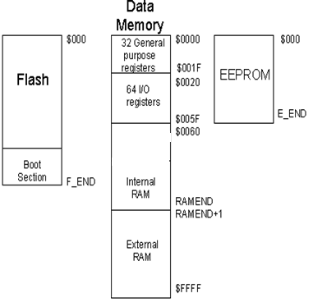
ATMega32 : Memory
AVR microcontrollers are Harvard architecture.
Each memory type has its own address space:
Type | Flash |  | RAM |  | EEPROM
 | F_END | Size, kB | RAMEND | Size, kB | E_END | Size, kB
Atmega8 | $0FFF | 8 | $045F | 1 | $1FF | 0.5
Atmega32 | $3FFF | 32 | $085F | 2 | $3FF | 1
Atmega64 | $7FFF | 64 | $10FF | 4 | $7FF | 2
Atmega128 | $FFFF | 128 | $10FF | 4 | $FFF | 4

Slide 16
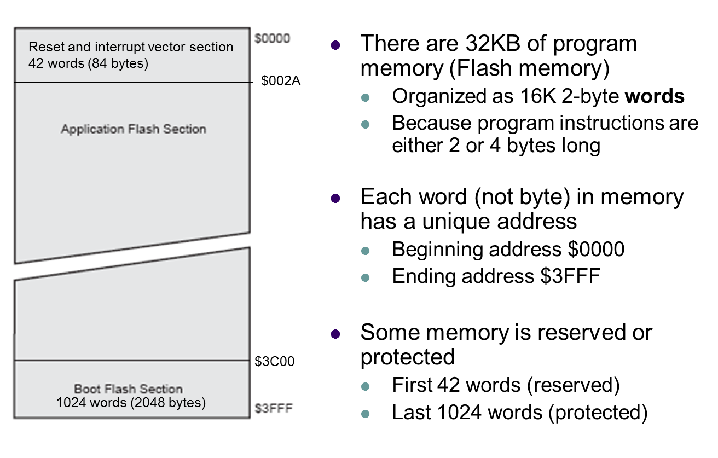
ATMega32 : Program Memory
Flash Memory Layout

Slide 17
ATMega32 : Data Memory
EEPROM
ATmega32 contains 1024 bytes of data EEPROM memory.
It is organized as a separate data space, in which single bytes can be read and written.
The EEPROM has an endurance of at least 100,000 write/erase cycles.
Different chip have different size of EEPROM memory
Chip | Bytes | Chip | Bytes | Chip | Bytes
ATmega8 | 512 | ATmega16 | 512 | ATmega32 | 1024
ATmega64 | 2048 | ATmega128 | 4096 | ATmega256RZ | 4096
ATmega640 | 4096 | ATmega1280 | 4096 | ATmega2560 | 4096

Slide 18
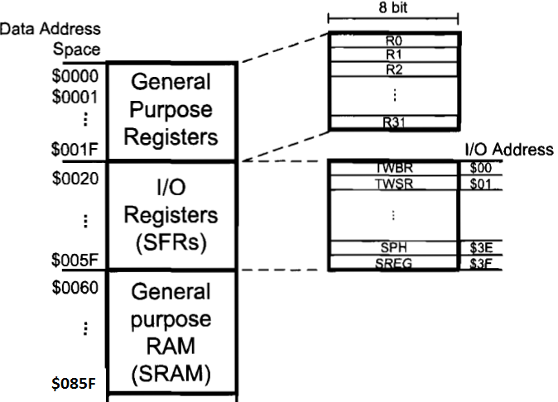
ATMega32 : Data Memory
The data memory is composed of three parts:
GPRs (general purpose registers),
Special Function Registers (SFRs), and
Internal data SRAM.

Slide 19
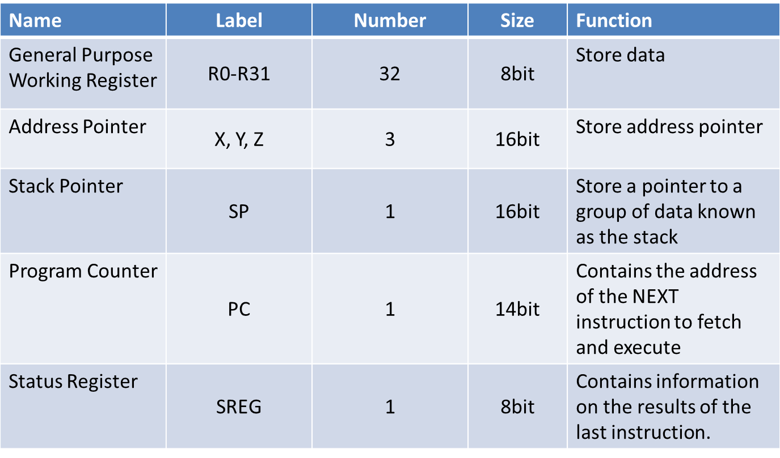
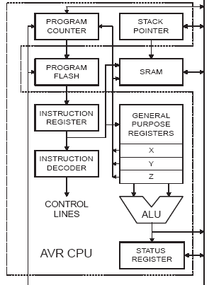
ATMega32 : Registers

Slide 20
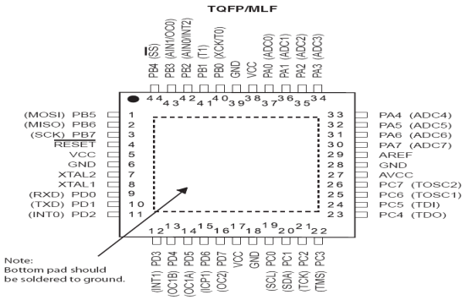
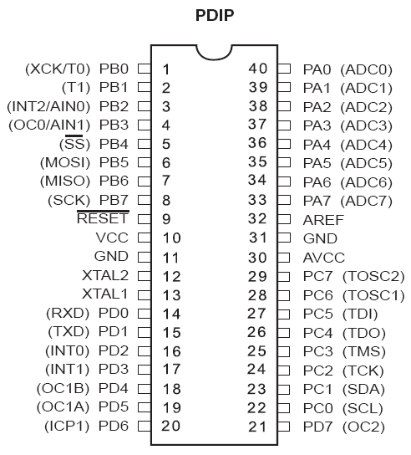


ATMega32 Pin out & Descriptions
Clears all the registers and restart the execution of program
Port B
Provides supply voltage to the chip. It should be connected to +5
Port A
Reference voltage for ADC
These pins are used to connect external crystal or RC oscillator
Supply voltage for ADC and portA. Connect it to VCC
Port C
Port D

Slide 21
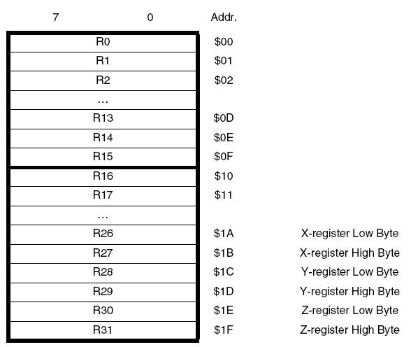
ATMega32 Programmer Model: Registers (GPRs)
“Six of the 32 registers can be used as three 16-bit indirect address register pointers for Data Space addressing –enabling efficient address calculations. One of the these address pointers can also be used as an address pointer for look up tables in Flash Program memory. These
added function registers are the 16-bit X-register, Y-register and Z-register, described later.”

Slide 22
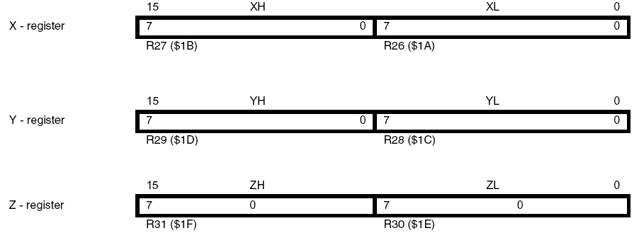
ATMega32 Programmer Model: Registers (GPRs)
The R26..R31 registers have some added functions to their general purpose usage. These registers are 16-bit address pointers for indirect addressing of the Data Space. The three indirect address registers X, Y, and Z are shown above.
In the different addressing modes these address registers have functions as fixed displacement, automatic increment, and automatic decrement

Slide 23
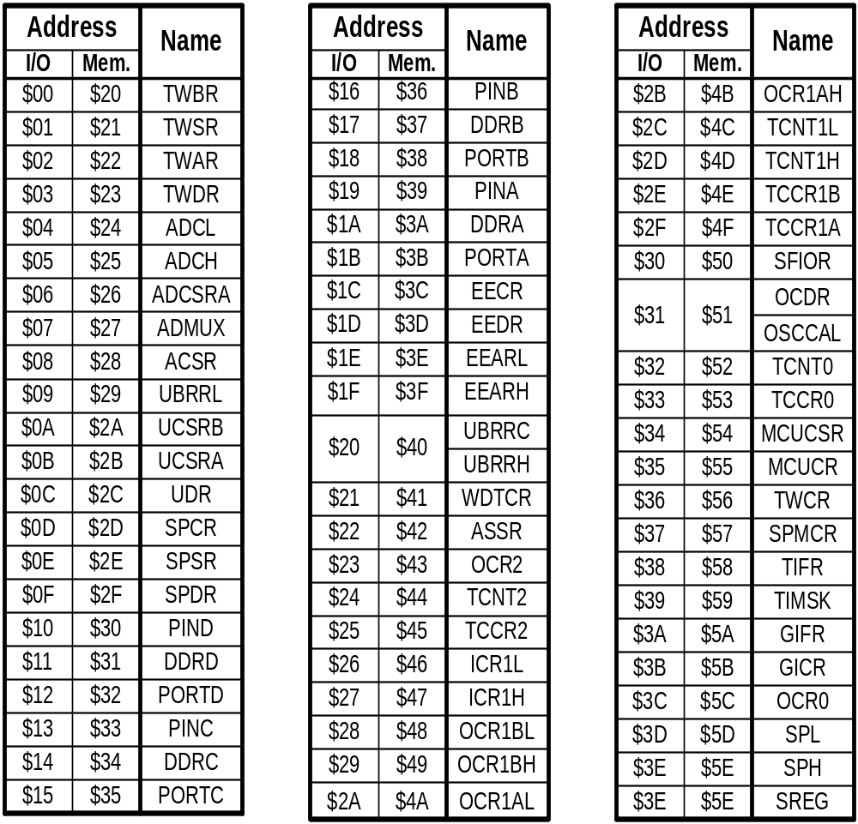
ATMega32 Programmer Model: I/O Registers (SFRs)
The I/O memory is dedicated to specific functions such as status register, timers, serial communication, I/O ports, ADC and etc.
Function of each I/O memory location is fixed by the CPU designer at the time of design. (because it is used for control of the microcontroller and peripherals)
AVR I/O memory is made of 8 bit registers.
All of the AVRs have at least 64 bytes of I/O memory location. (This 64 bytes section is called standard I/O memory)
In other microcontrollers, the I/O registers are called SFRs (Special Function Registers)

Slide 24
Topics
Microcontrollers vs. Microprocessors
Most common microcontrollers
AVR Microcontroller Architecture
Introduction to ATMega32 Architecture
Introduction To Basic AVR Assembly Programming
+ Basic Arthmetic and Logic operation
+ General Input Output ( GPIO)
+ Data Transfer Instruction

Slide 25
A simple Assembly program example 1
Write a program that calculates 19 + 95
LDI R16, 19 ;R16 = 19
LDI R20, 95 ;R20 = 95
ADD R16, R20 ;R16 = R16 + R20
CPU
ALU
R0
R1
R2
…
SREG:
H
N
Z
I
T
S
V
C
R15
R16
R17
PC
…
Instruction decoder
R30
R31
Instruction Register
registers

Slide 26
A simple Assembly program example 2
Write a program that calculates 19 + 95 + 5
Solution 1 : Using 3 Registers
LDI R16, 19 ;R16 = 19
LDI R20, 95 ;R20 = 95
LDI R21, 5 ;R21 = 5
ADD R16, R20 ;R16 = R16 + R20
ADD R16, R21 ;R16 = R16 + R21
Solution 2 : Using 2 Registers
LDI R16, 19 ;R16 = 19
LDI R20, 95 ;R20 = 95
ADD R16, R20 ;R16 = R16 + R20
LDI R20, 5 ;R20 = 5
ADD R16, R20 ;R16 = R16 + R20

Slide 27
A simple Assembly program example 1
Write a program that calculates 22 + 33 - 44
LDI R16, 22 ;R16 = 22
LDI R17, 33 ;R17 = 33
LDI R18, 44 ;R18 = 44
ADD R16, R17 ;R16 = R16 + R17
SUB R16, R18 ; R16 = R16 + R17
CPU
ALU
R0
R1
R2
…
SREG:
H
N
Z
I
T
S
V
C
R16=22
R17=33
R18=44
PC
…
Instruction decoder
R30
R31
Instruction Register
registers

Slide 28
Topics
Microcontrollers vs. Microprocessors
Most common microcontrollers
AVR Microcontroller Architecture
Introduction to ATMega32 Architecture
Introduction To Basic AVR Assembly Programming
+ Basic Arthmetic and Logic operation
+ General Input Output ( GPIO)
+ Data Transfer Instruction

Slide 29
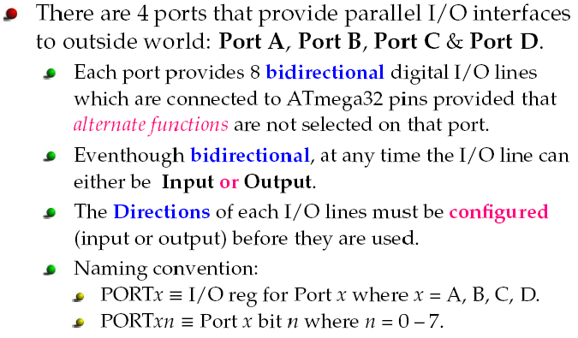
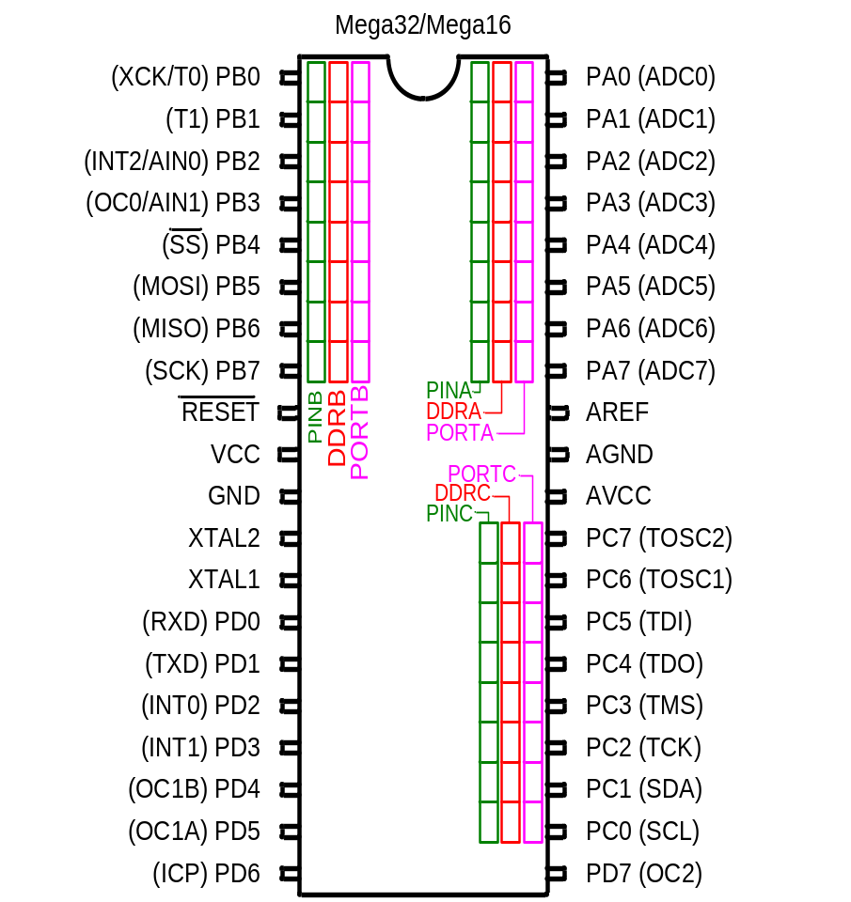
ATMega32 GPIO Programming
Using Assembly Language

Slide 30
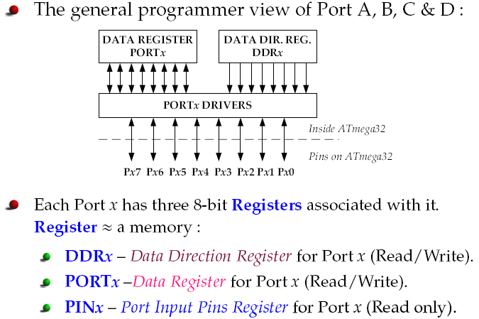
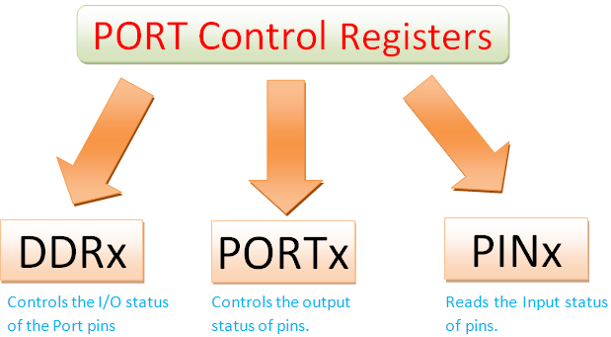
ATMega32 Pin out & Descriptions

Slide 31
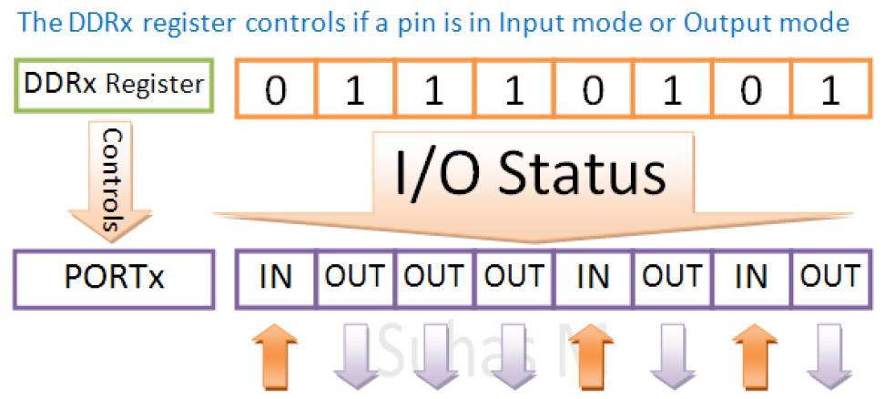
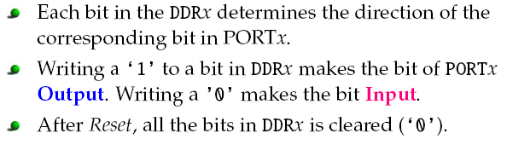
ATMega32 Pin out & Descriptions
Defining a pin as either Input or Output – The DDRx Registers
LDI R16,0x75 ;R16 = 0b01110101
OUT DDRx,R16 ;DDRA = R16
LDI R20,0x55 ;R16 = 0b01010101
OUT PORTx,R20 ;PORTx = R20 = 0b01010101

Slide 32
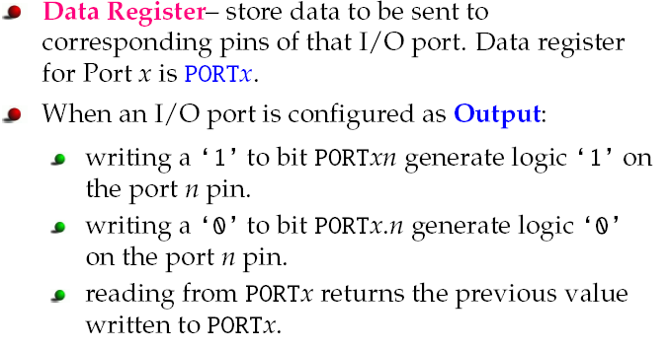
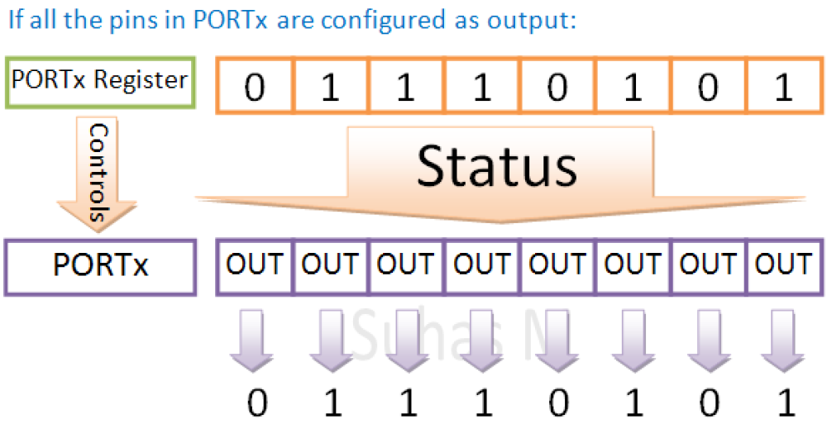
ATMega32 Pin out & Descriptions
Case 1 : To make a pin go high or low ( if it is an output pin)- Data Register PORTx

Slide 33
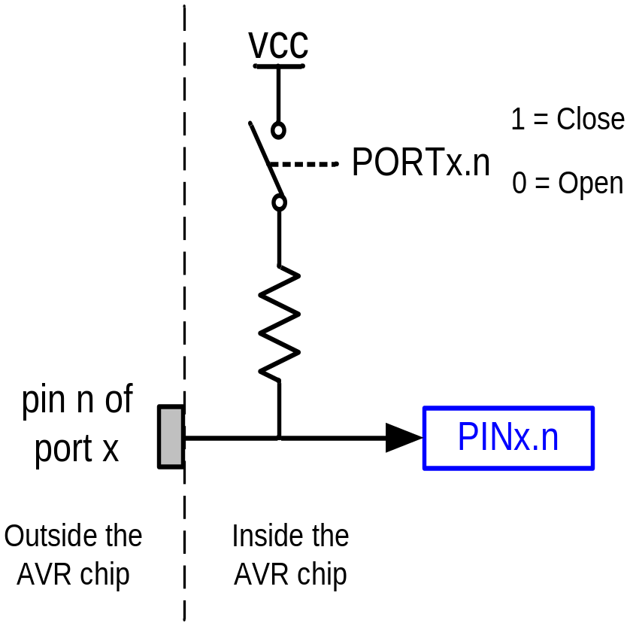
Pull-up resistors are used in electronic logic circuits to ensure that inputs to logic systems settle at expected logic levels if external devices are disconnected or high-impedance

Slide 34
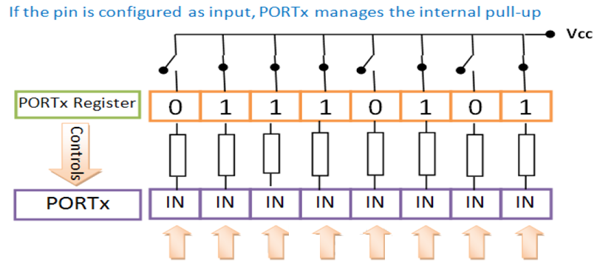
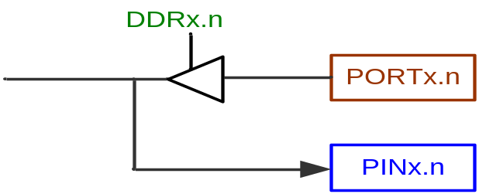
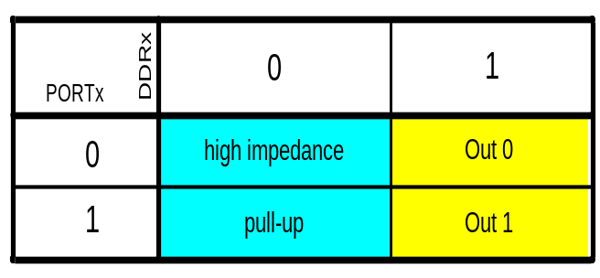
ATMega32 Pin out & Descriptions
Case 2 : To activate / Deactivate pull up resistors-Data Register PORTx

Slide 35
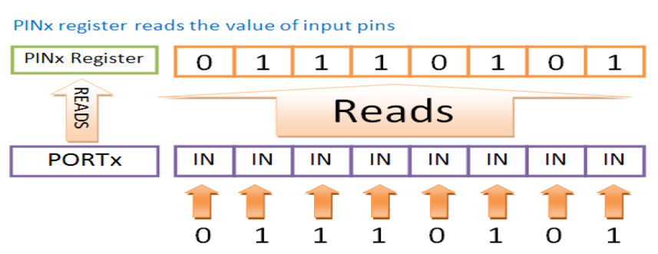
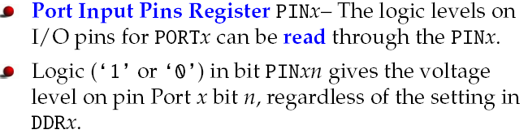
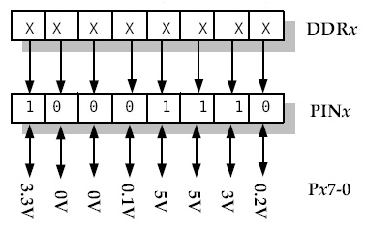
ATMega32 Pin out & Descriptions
The PINx register gets the reading from the input pins of the MCU

Slide 36
A simple Assembly program example 1
Write a program that input 8-bit data from PortB then output to PortC.
Loop:
IN R18, PINB
OUT PORTC, R18
JMP LOOP
.include "M32DEF.INC"
LDI R16,0x00;
OUT DDRC,R16;
LDI R16,0b11111111
OUT PORTB,R16
LDI R16,0xFF
OUT DDRB,R16
WHILE_1:
IN R16,PINC;
OUT PORTB,R16;
JMP WHILE_1
CPU
ALU
R0
R1
R2
…
SREG:
H
N
Z
I
T
S
V
C
R15
R16
R17
PC
…
Instruction decoder
R30
R31
Instruction Register
registers

Slide 37
GPIO Control Assembly Example Code
Write an Assembly program to control turn on and turn off 8 LEDs connected to 8 pins of PORTB with 1 second delay
.include "M32DEF.INC"
LDI R16,0xFF;
OUT DDRB,R16;
WHILE_1:
LDI R17,0x00;
OUT PORTB,R17;
CALL delay_1s
LDI R17,0xFF;
OUT PORTC,R17;
CALL delay_1s
JMP WHILE_1
delay_1s:
LDI R20,68 ; 1 Cycle
DL3: LDI R21,100 ; 1
DL2: LDI R22,48 ; 1
DL1: DEC R22 ; 1
BRNE DL1 ; 1/2
DEC R21 ; 1
BRNE DL2 ; 1/2
DEC R20 ; 1
BRNE DL3 ; 1/2
RET ; 3

Slide 38
Topics
Microcontrollers vs. Microprocessors
Most common microcontrollers
AVR Microcontroller Architecture
Introduction to ATMega32 Architecture
Introduction To Basic AVR Assembly Programming
+ Basic Arthmetic and Logic operation
+ General Input Output ( GPIO)
+ Data Transfer Instruction

Slide 39
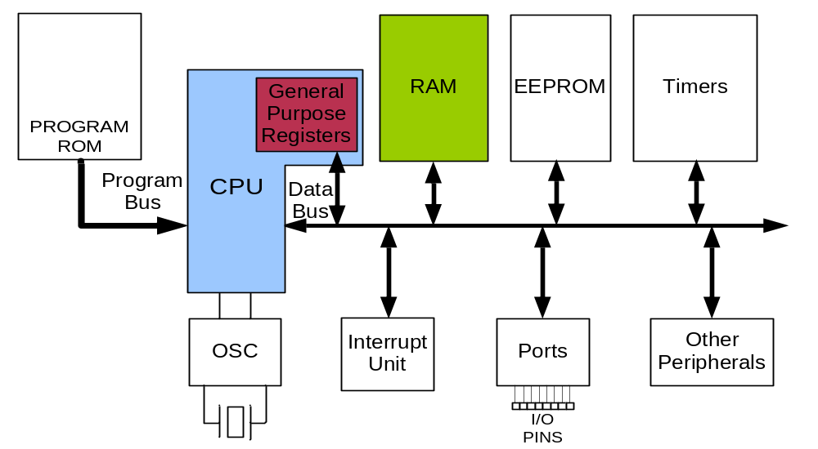
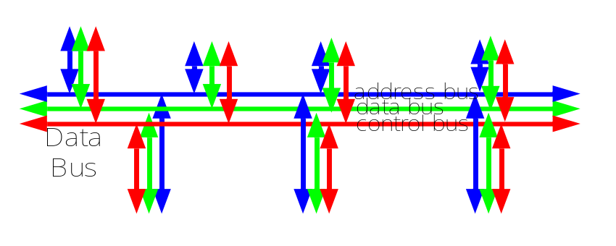
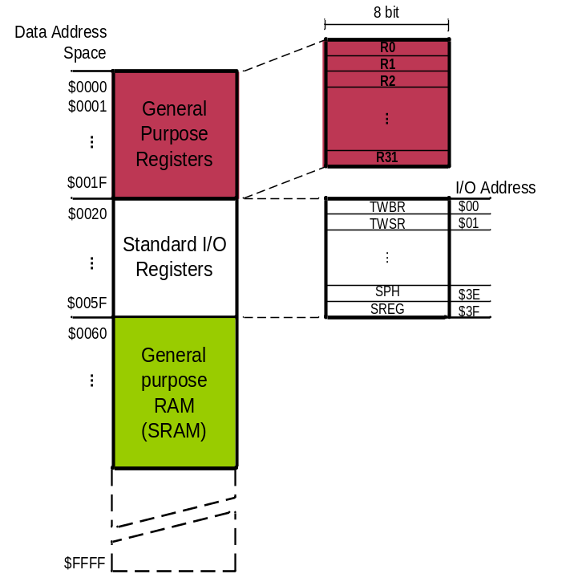
Data Transfer Instruction Examples
Example: Add contents of location 0x90 to contents of location 0x95 and store the result in location 0x313.
Example: Store 0x53 into the SPH register. The address of SPH is 0x5E
Example: What does the following instruction do?
LDS R20,2
LDS (Load direct from data space)
STS (Store direct to data space)
Example: Write a program that stores 55 into location 0x80 of RAM.
Example: Write a program that copies the contents of location 0x80 of RAM into location 0x81.
Solution:
LDS R20, 0x90 ;R20 = [0x90]
LDS R21, 0x95 ;R21 = [0x95]
ADD R20, R21 ;R20 = R20 + R21
STS 0x313, R20 ;[0x313] = R20
LDS Rd, addr ;Rd = [addr]
STS addr,Rd ;[addr]=Rd
Solution:
LDI R20, 0x53 ;R20 = 0x53
STS 0x5E, R20 ;SPH = R20
Solution:
LDI R20, 55 ;R20 = 55
STS 0x80, R20 ;[0x80] = R20 = 55
Answer:
It copies the contents of R2 into R20; as 2 is the address of R2.
Example:
LDS R1, 0x60
Example:
STS 0x60,R15 ; [0x60] = R15
Solution:
LDS R20, 0x80 ;R20 = [0x80]
STS 0x81, R20 ;[0x81] = R20 = [0x80]

Slide 40
Data Transfer Instruction Examples
Example: Write a program that adds the contents of the PINC IO register to the contents of PIND and stores the result in location 0x90 of the SRAM
OUT (OUT to IO location)
IN (IN from IO location)
Solution:
IN R20,PINC ;R20 = PINC
IN R21,PIND ;R21 = PIND
ADD R20,R21 ;R20 = R20 + R21
STS 0x90,R20 ;[0x90] = R20
OUT IOAddr,Rd ;[addr]=Rd
IN Rd,IOaddress ;Rd = [addr]
Using Names of IO registers
Example:
OUT SPH,R12 ;OUT 0x3E,R12
IN R15,SREG ;IN R15,0x3F
Example:
OUT 0x3F,R12 ;SREG = R12
OUT 0x3E,R15 ;SPH = R15
Example:
IN R1, 0x3F ;R1 = SREG
IN R17,0x3E ;R17 = SPH

Slide 41
Summarized
Classification of Data Transfer Instructions
SRAM
(Data memory)
FLASH
(Program memory)
st, std, sts
lpm
ld, ldd, lds
GPR
(General registers)
mov, movw
in
push
pop
out
ldi
I/O space
Stack
Constant

Slide 42
Data transfer instructions (1/2)
Mne-monics | Operands | Operation | Words | Clocks | Note
MOV | Rd, Rr | Rd ← Rr | 1 | 1 | 0 ≤ d ≤ 31, 0 ≤ r ≤ 31
MOVW | Rd+1:Rd, Rr+1:Rr | Rd+1:Rd ← Rr+1:Rr | 1 | 1 | d,r ∈ {0,2,...,30}
LDI | Rd, K | Rd ← K | 1 | 1 | d = 16..31, 0 ≤ K ≤ 255
LDS | Rd, k | Rd ← (k) | 2 | 2 | 0 ≤ k ≤ 65535
STS | k, Rr | (k) ← Rr | 2 | 2
LD | Rd, I_reg | Rd ← (I_reg) | 1 | 2 | I_reg = X, Y, or Z
LD | Rd, I_reg+ | Rd ← (I_reg), I_reg ← I_reg + 1 | 1 | 2 | 0 ≤ d ≤ 31
LD | Rd, I_reg- | Rd ← (I_reg), I_reg ← I_reg - 1 | 1 | 2
LD | Rd, +I_reg | I_reg ← I_reg + 1, Rd ← (I_reg) | 1 | 2
LD | Rd, -I_reg | I_reg ← I_reg - 1, Rd ← (I_reg) | 1 | 2
ST | I_reg, Rr | (I_reg) ← Rr | 1 | 2 | I_reg = X, Y, or Z
ST | I_reg+, Rr | (I_reg) ← Rr, I_reg ← I_reg + 1 | 1 | 2 | 0 ≤ r ≤ 31
ST | I_reg-, Rr | (I_reg) ← Rr, I_reg ← I_reg – 1 | 1 | 2
ST | +I_reg, Rr | I_reg ← I_reg + 1, (I_reg) ← Rr | 1 | 2
ST | -I_reg, Rr | I_reg ← I_reg - 1, (I_reg) ← Rr | 1 | 2

Slide 43
Data transfer instructions (2/2)
Mnemonics | Operands | Operation | Words | Clocks | Note
LDD | Rd, Z+q | Rd ← (Z+q) | 1 | 2
STD | Y+q, Rr | (Y+q) ← Rr | 1 | 2 | 0 ≤ r ≤ 31, 0 ≤ q ≤ 63
STD | Z+q, Rr | (Z+q) ← Rr | 1 | 2
LPM |  | R0 ← (Z) in program memory | 1 | 3 | Z is program mem. pointer
LPM | Rd, Z | Rd ← (Z) in program memory | 1 | 3 | 0 ≤ d ≤ 31
LPM | Rd, Z+ | Rd ← (Z), Z ← Z + 1 | 1 | 3
IN | Rd, A | Rd ← SFR with addr of A | 1 | 1 | 0 ≤ d, r ≤ 31, 0 ≤ A ≤ 63
OUT | A, Rr | SFR with addr of A ← Rr | 1 | 1 | A is an I/O Address
PUSH | Rr | (SP) ← Rr, SP ← SP – 1 | 1 | 2 | SP is Stack Pointer
POP | Rd | SP ← SP + 1, Rd ← (SP) | 1 | 2

Slide 44
A simple Assembly program example 1
Write a program that read data from RAM location 0x600 then store to 0x609 RAM location.
.include "M32DEF.INC"
LDS R16,0x600;
STS 0x609,R16;
Or
// configure PORTB as 8 bit inputs
LDI R16,0x00;
OUT DDRB, R16
// configure PORTC as Outputs
LDI R17, 0b11111111
OUT DDRC, R17
CPU
ALU
R0
R1
R2
…
SREG:
H
N
Z
I
T
S
V
C
R15
R16
R17
PC
…
Instruction decoder
R30
R31
Instruction Register
registers

Slide 45
A simple Assembly program Quiz 2
Write a program that store hexa numbers ranging from 0x01 to 0x06 to 6 RAM locations 0x601 to 0x606, read out the content of these memory locations, calculate the sum of all these numbers then output the sum result to PORTB.
.include "M32DEF.INC"
LDS R16,0x600;

Slide 46
A simple Assembly program Quiz 2
Write a program that store hexa numbers ranging from 0x01 to 0x06 to 6 RAM locations 0x601 to 0x606, read out the content of these memory locations, calculate the sum of all these numbers then output the sum result to PORTB. Optimize the above code to solve the this problem.
.include "M32DEF.INC"
LDS R16,0x600;

Slide 47
Write assembly program for the ATmega32 microcontroller that adds two 8-bit numbers stored in two specific memory locations and stores the result in another memory location.

Slide 48
Q&A
Question and Answers

